Slide 1
Summer School

Slide 2
Stanford CS231N CNNs for Visual Recognition
Video
Course Note

Slide 3
Videos I
Introduction to This Course
Image classification
Loss Functions and Optimization
Introduction to Neural Network
Convolutional Neural Network

Slide 4
Videos II
Training Neural Network I
Training Neural Network II
Deep Learning Software
CNN Architectures
Recurrent Neural Networks

Slide 5
Videos III
Detection and Segmentation
Visualizing and Understanding
Generative Models
Deep Reinforcement Learning
Efficient Methods and Hardware for DL
Adversarial Examples and Adversarial Training

Slide 6
Course Notes I
Module 0: Preparation
Setup Instructions
Python / Numpy Tutorial
IPython Notebook Tutorial
Google Cloud Tutorial
AWS Tutorial

Slide 7
Course Notes II
Module 1: Neural Networks
Image Classification: Data-driven Approach, k-Nearset Neighor, train/val/test splits
Linear classification: Support Vector Machine, Softmax
Optimization: Stochastic Gradient Descent
Backprapagation, Intuitions
Notes:
接触这个，你们可以学一点 pytorch 或 tensorflow(keras) 的知识

Slide 8
Course Notes III
Module 1: Neural Networks
NN: Setting up the Architecture
NN: Setting up the Data and the Loss
NN: Learning and Evaluation
NN: Minimal Neural Network Case Study

Slide 9
Course Notes IV
Module 2: Convolutional Neural Networks
CNN：Architectures, Convolution / Pooling Layers
Understanding and Visualizing CNNs
Transfer Learning and Fine-tuning CNNs

Slide 10
Assignments
Image Classfication, kNN, SVM, Softmax, Neural Network
Full-Connected Nets, Batch Normalization, Dropout, Convolutional Nets
Image Captioning with Vanilla RNNs, Image Captioning with LSTMs, Network Visualization, Style Transfer, Generative Adversarial Network
Notes:
结业考核的一部分。

Slide 11
动手学深度学习
Video
Course Note
Discuss

Slide 12
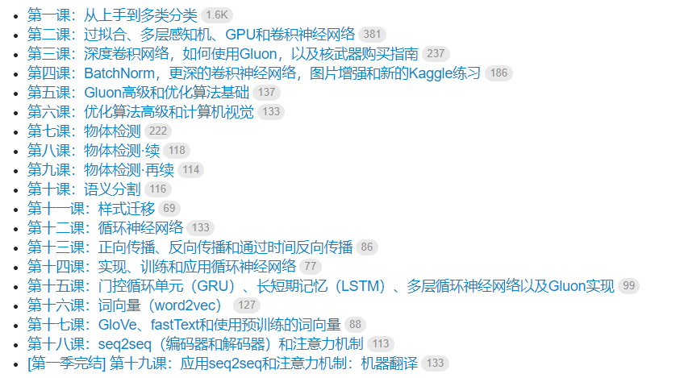
Videos

Slide 13
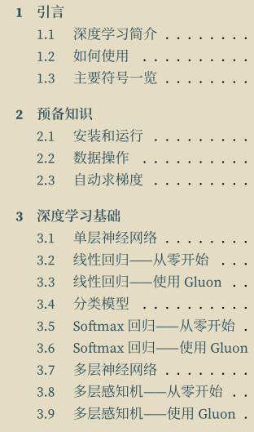
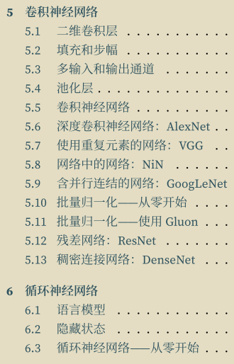
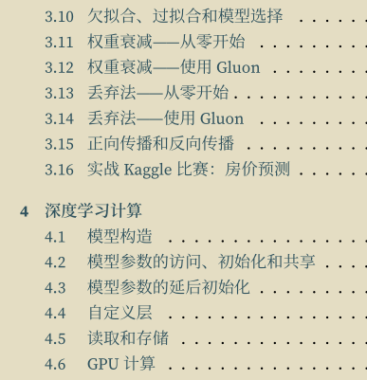
Course Notes I

Slide 14
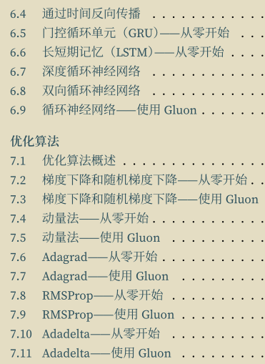
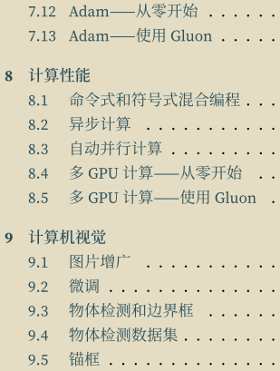
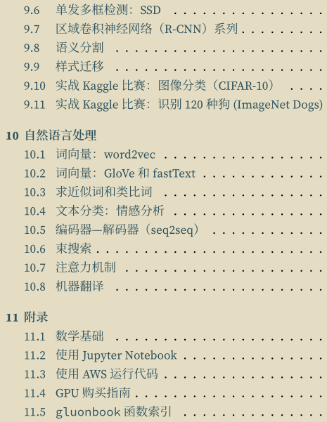
Course Notes II

Slide 15
Deep Learning Specialization
Coursera
Notes:
Tfboys一条龙

Slide 16
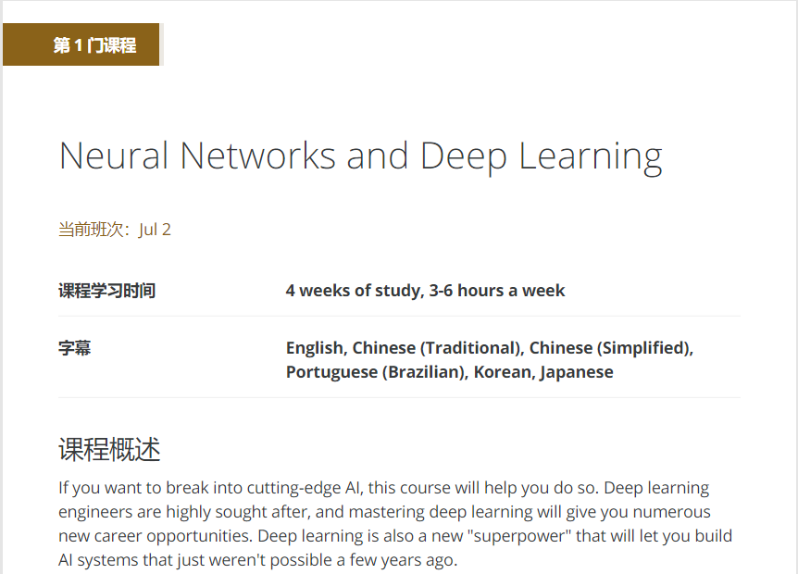
Course I

Slide 17
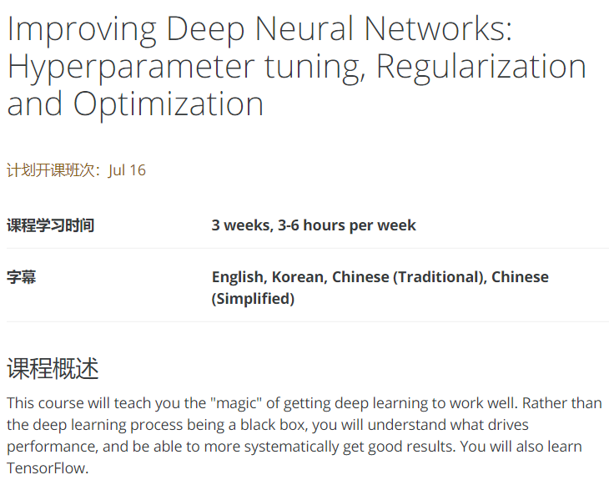
Course II

Slide 18
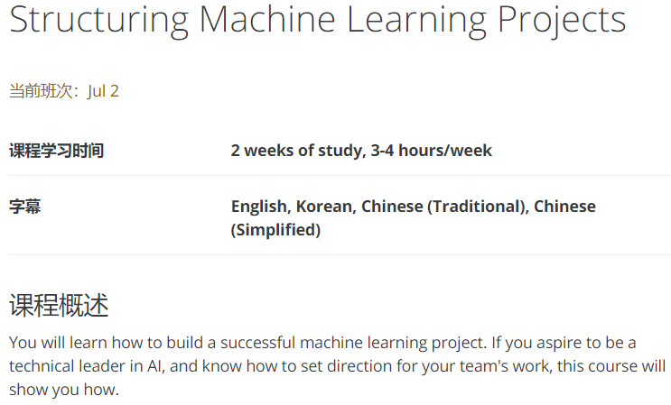
Course III

Slide 19
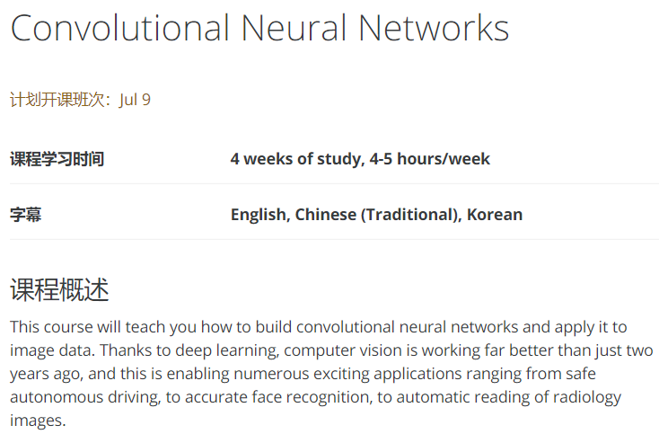
Course IV

Slide 20
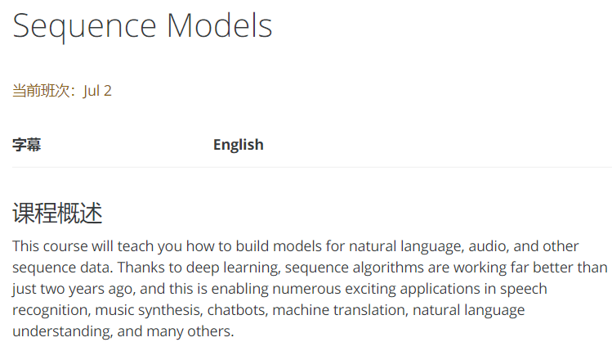
Course V

Slide 21
Recommend Materials

Slide 22
Textbooks
周志华 机器学习 (西瓜书)
李航 统计机器学习

Slide 23
English blogs
karpathy.github.io
colah.github.io
machinethink.net
Must Know Tips
timvieira.github.io
Notes:
结业考核的一部分。

Slide 24
Chinese Blogs
zouxy09
tornadomeet
miaoerduo
AI之路
韩炳涛

Slide 25
Openbooks
Deep Learning Book
Machine Learning Yearning
深度学习实践手册
迁移学习简明手册

Slide 26
Awesome lists
Awesome CS Courses
Awesome Deep Vision
Awesome Deep Learning
Awesome Computer Vision

Slide 27
Paper searching
scholar.google.com
arxiv.org
cvpapers.com
thecv.com

